Slide 1




AUTOMATED RESUME
SCREENING
Smart and Automated Future

Slide 2

TEAM DETAILS
Yatham Kshithija – AP23110010902
Patcharu Navya Sai – AP23110011406
Katta Yoga Varshitha–AP23110010666
Udumula Susmitha – AP23110010368
Radhika-AP23110010125

Slide 3

PROBLEM STATEMENT &
OBJECTIVES
Problem Statement
Traditional resume screening is time-consuming, error-prone, and unable to manually compare large volumes of resumes efficiently.
Objectives
Automate resume extraction and skill identification
Compare candidate skills with job description
Generate a fit score for ranking candidates
Reduce manual HR workload and increase accuracy

Slide 4
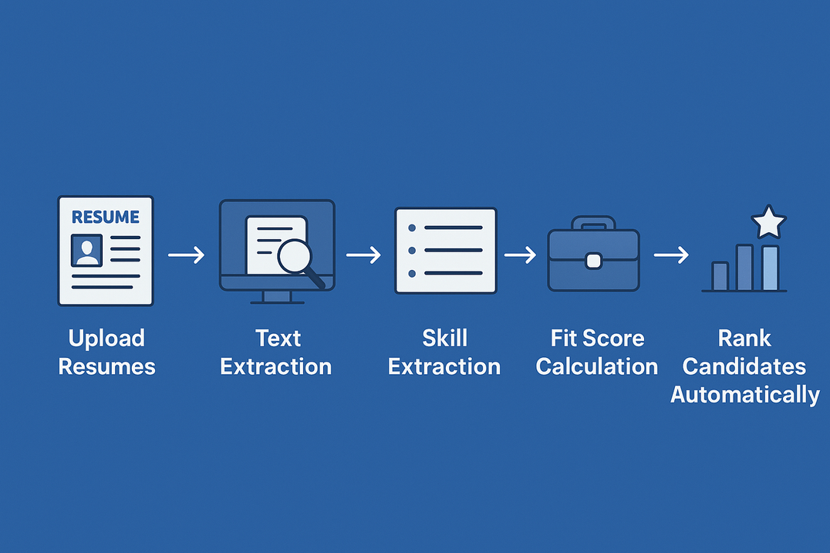
PROPOSED SOLUTION & WORKFLOW
How Our AI HR Assistant Works ?
Upload Resumes (PDF, DOCX, Images)
Text Extraction using OCR / NLP
Skill Extraction using keyword matching + ML models
Job Description Analysis
Fit Score Calculation
Rank Candidates Automatically

Slide 5
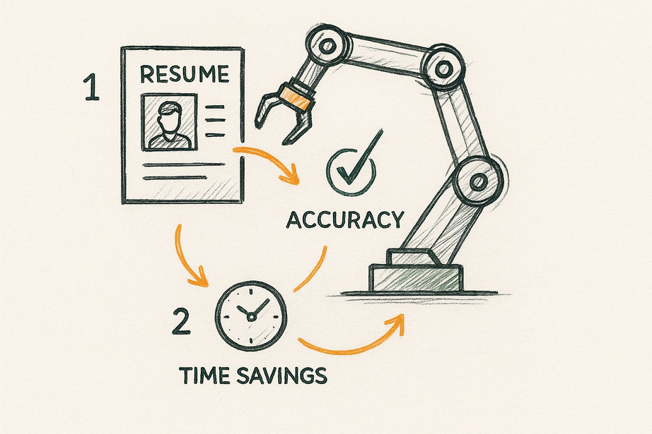
DATASET & METHODOLOGY
Dataset
Sample resumes (PDF, DOCX)
Job descriptions from HR datasets
Skill keyword lists
Pre-trained embeddings (Word2Vec / BERT)
Methodology
Text extraction (PyPDF2, docx)
Preprocessing → tokenization, stopwords removal
TF-IDF / BERT-based vectorization
Cosine similarity for match scoring
Ranking algorithm for profile selection

Slide 6
TECHTECHNOLOGIES USED
2. Frontend Technologies
HTML5 – Structure of the web interface
CSS3 – Styling the webpage
JavaScript – Basic interactions and client-side logic
🔧 1. Backend Technologies
Python 3.x
Flask or FastAPI (for REST API)
NLP Libraries
NLTK
spaCy
scikit-learn

Slide 7
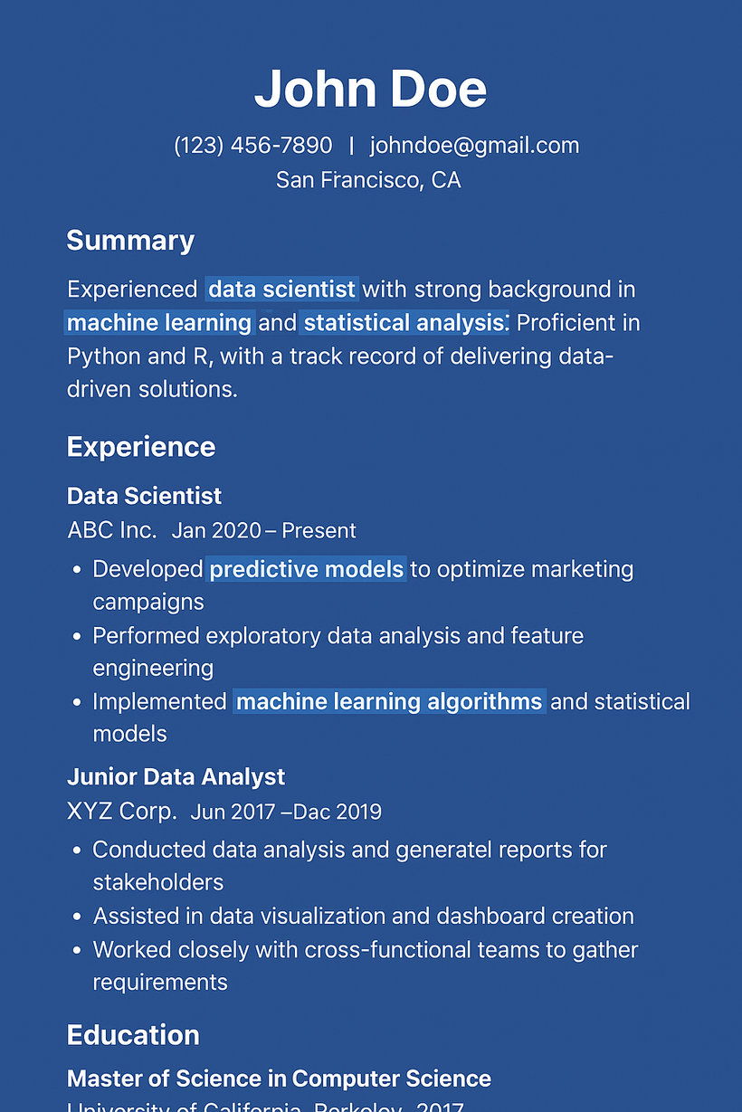

RESUME PROCESSING AND SKILL EXTRACTION
What the AI Extracts from Resumes
Skills (Technical & Soft Skills)
Education details
Experience years & job roles
Certifications & projects
Keywords matching job needs

Slide 8
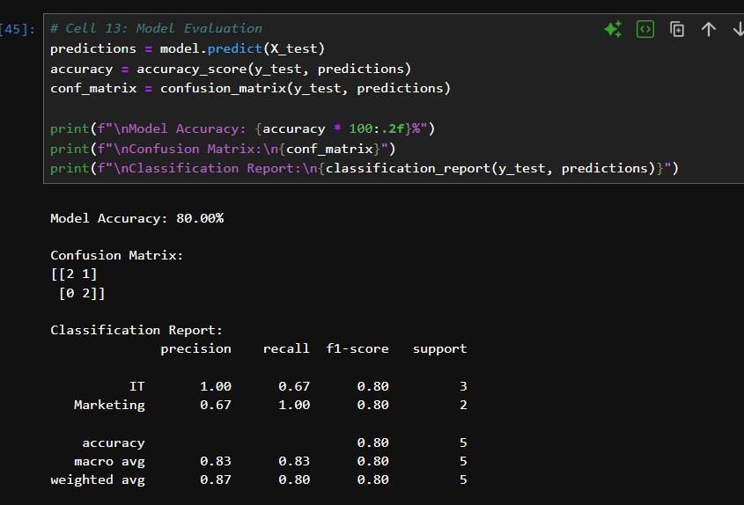
RESULT& FINDINGS
AUTOMATED EXTRACTION ACCURACY: 80%
MATCHING ACCURACY IMPROVED BY 40%
COMPARED TO MANUAL SCREENING
TIME TAKEN FOR SCREENING REDUCED FROM HOURS TO SECONDS
FIT SCORE RANKING HELPS HR SHORTLIST THE BEST CANDIDATES FASTER

Slide 9

CONCLUSION
Benefits of the AI HR Assistant
Speeds up hiring by 70%
Reduces manual load for HR
Improves accuracy & fairness
Provides data-driven, unbiased hiring decisions
Future Enhancements
Integrate chatbot for candidate interaction
Add multi-language resume support
Deploy on cloud (AWS/GCP)
Add ML-based predictive hiring success score

Slide 10
THANK YOU

